Slide 1
Addressing social determinants of TB to End TB Chakaya JM TB and Lung Health Symposium Nairobi Hospital Convention Centre September 29, 2025

Slide 2
What is the problem that needs to be solved?

Slide 3

The global burden of TB remains too high
Incidence: 10.8 million (10.1-11.7)
Mortality: 1.25 million ( 1.13-1.37) deaths
The challenge of drug resistant TB: RR/MDRTB: 400,000 ( 360,000-440,000)

Slide 4
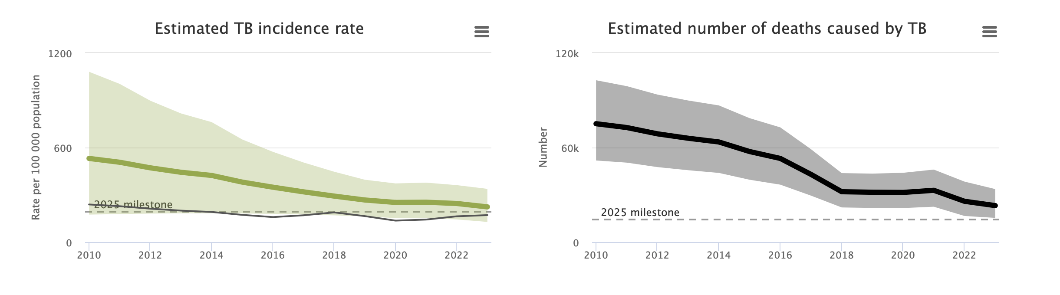
Kenya: on track to achieve the End TB Strategy targets?

Slide 5
Is Kenya on track to achieve the 2030 SDG/End TB Targets?
179, 000 people developed TB in 2015
124, 000 people developed TB in 2025
Can we get to fewer that 35,000 people developing TB by 2030?

Slide 6
What about TB deaths?
57, 000 people died of TB in 2015
23, 000 people died of TB in 2023
Can we get to less than 5, 700 people dying of TB by 2030?

Slide 7
What is or could hold us back?

Slide 8
Social determinants of TB
What Are Social Determinants of Health?
Conditions in which people are born, grow, live, work, and age
Influence health risks and outcomes
Directly impact TB transmission, progression, and care

Slide 9
The key social determinats of TB
Poverty
Poor housing
Undernutrition
Poor access to health care services
Low education level
Migration, especially following conflict
Gender inequality
Occupations, such as mining /health care professionals

Slide 10
How are we doing with these social determinats?

Slide 11
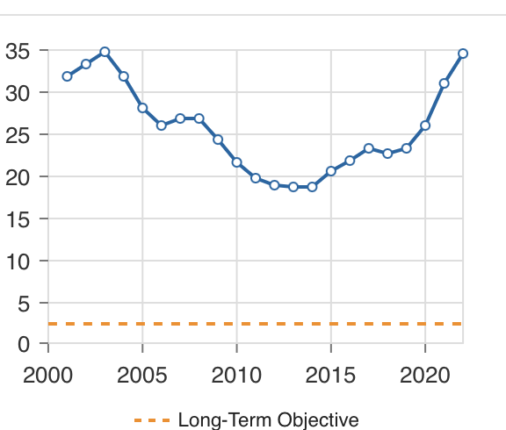
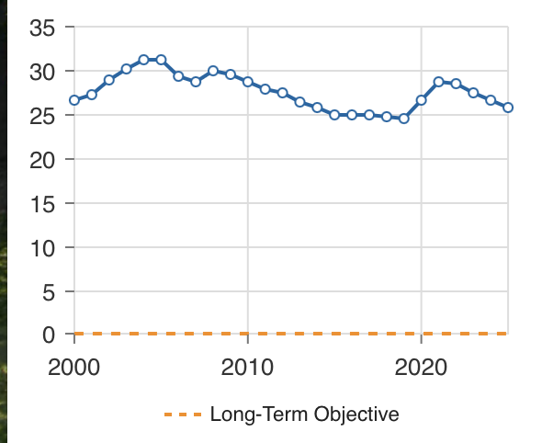
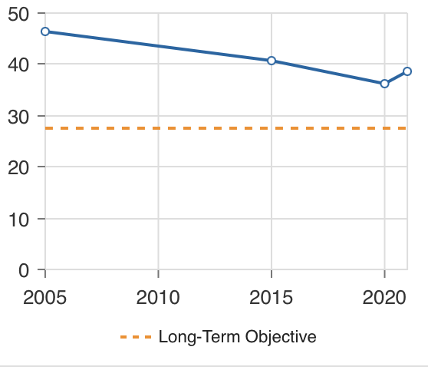
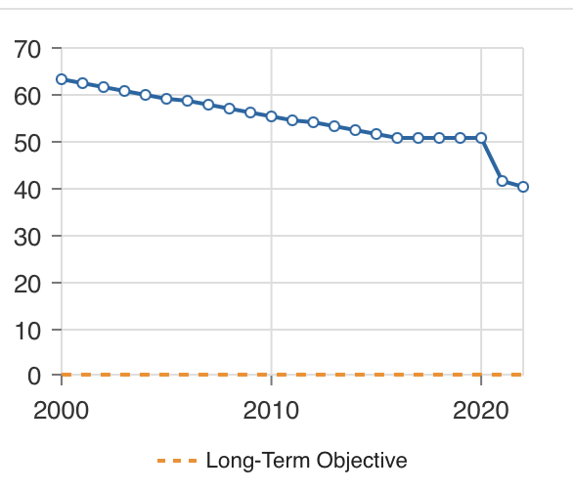
Prevalence of undernourishment
Poverty Head Count Ratio at USD2.15/day
Inequality – the GINI Coefficient
Proportion of urban population living in slums
Source: SDG dashboard

Slide 12
Poverty, social deprivation and growth of urban slum populations: the source of all TB

Slide 13
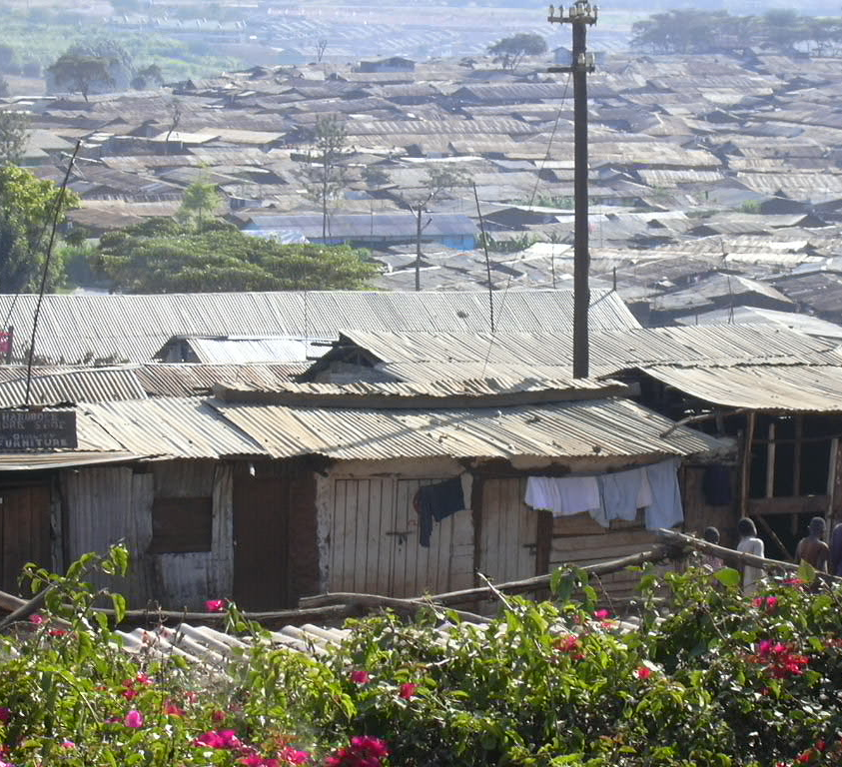
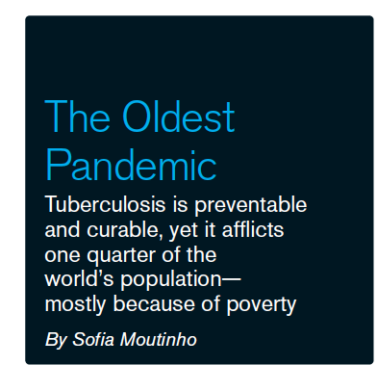
Poverty, deprivation and inequity –the core drivers of the persistence of the TB Pandemic
S16/Nature/Vol 605. 19 May 2022

Slide 14
Should we be concerned about climate change?

Slide 15
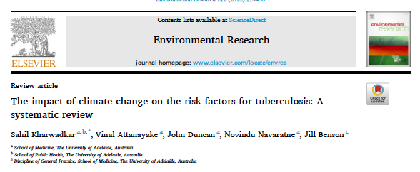
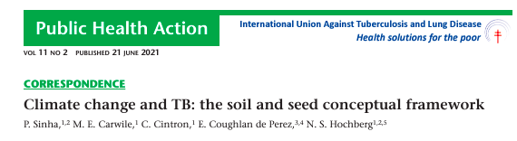
Climate change
Risk of natural disasters such as heat waves, droughts and flooding.
Displacement of people.
Food insecurity.
Increased transmission ( the seed) and or vulnerability (the soil) of populations TB.

Slide 16
Is our response balanced?

Slide 17
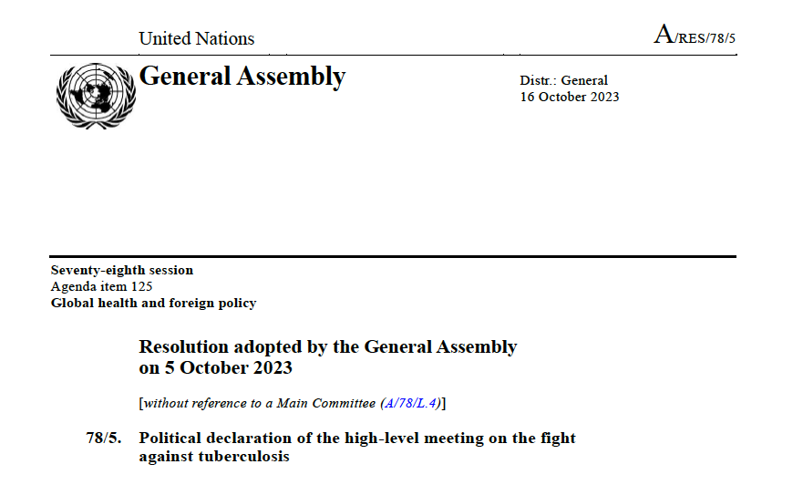

Slide 18
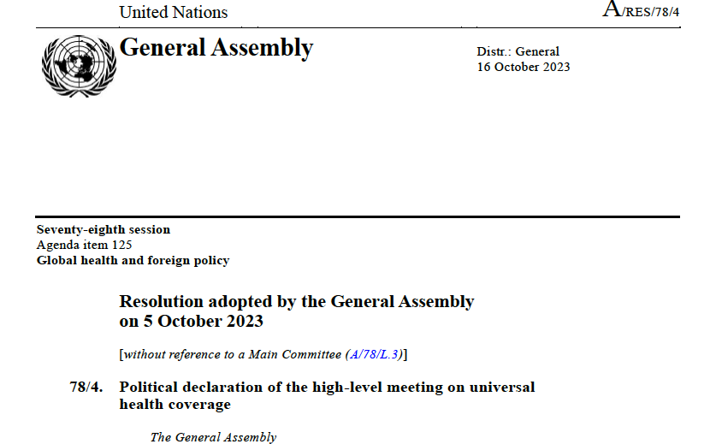

Slide 19
The biomedical approach

Slide 20
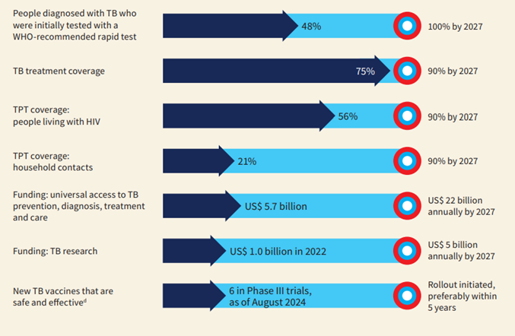

Slide 21
But could the answer be outside the health sector?

Slide 22
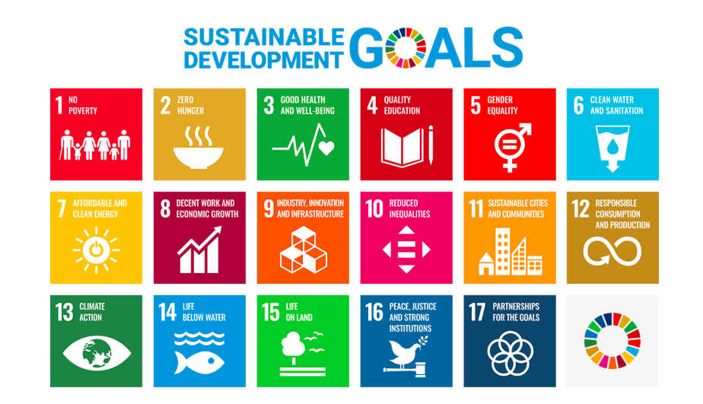

Slide 23
Overcoming poverty is not a gesture of charity, it is an act of justice. Nelson Mandela

Slide 24
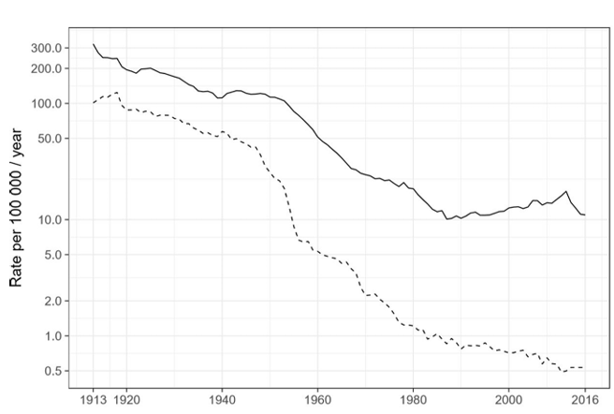
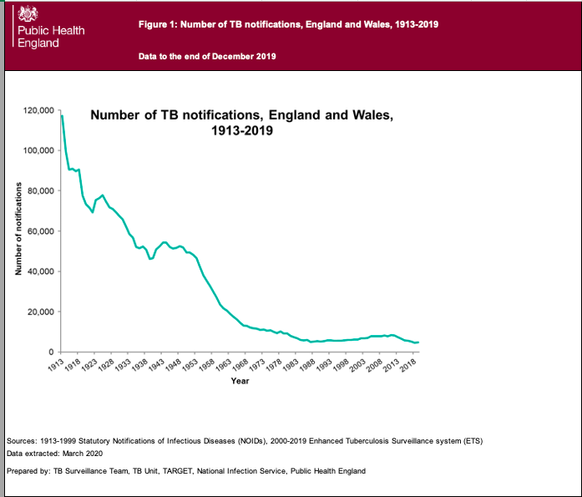
Tuberculosis incidence, mortality and notification in England and Wales, 1913 - 2018
GOV.UK. Tuberculosis (TB): annual notification and mortality data (1913 onwards). https://www. gov.
uk/ government/ publications/ tuberculosis- tb- annualnotifications-1913- onwards

Slide 25
What worked in England and Wales?
Improvement in people’s living conditions
Universal access to TB services : the critical role of the TB dispensary
Social protection schemes
Glaziou P et al. Thorax 2018; 73(8): 702-703
Sue Bowden and Alex Sadler. Med Hist. 2015 ; 59 (1): 101-135

Slide 27
What was done in Alaska?
Following demonstration of the efficacy of INH to prevent TB
Community wide screening for TB
Treatment of active TB disease when identified
Widespread use of INH for prophylaxis
Result: greater than 10% decline in TB incidence per year

Slide 28

Parameter | Baseline | Year 4
TB Prevalence in adults >15 years | 389/100,000 | Intervention | Control
 |  | 126/100,000 | 226/100,00

Slide 29
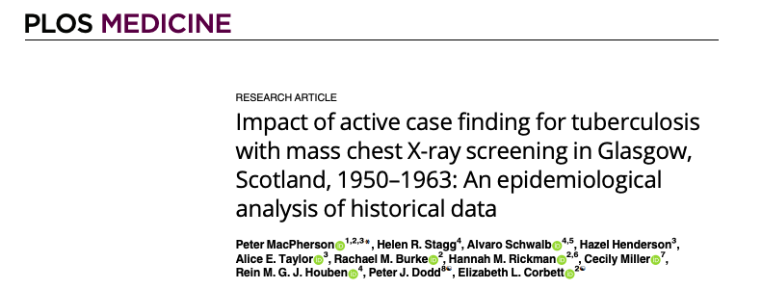
Single round of screening with MMR
Doubling of CNR in the intervention year compared to the previous year
35% decline in CNR in the year following the intervention

Slide 30
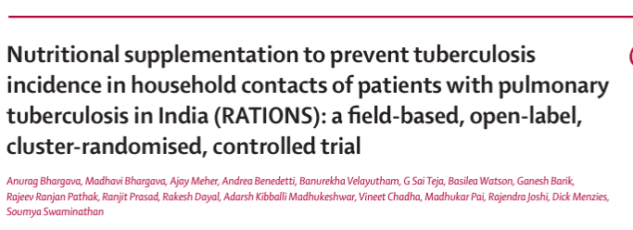

And food works: evidence on nutrition as a preventive tool for TB
Randomized trial on the effect of nutritional support on tuberculosis incidence in household contacts in Jharkhand state of India
“…the nutritional intervention was associated with substantial (39–48%) reduction in tuberculosis incidence in the household during 2 years of follow-up.”
Lancet 2023; 402: 627–40 Published Online August 8, 2023 https://doi.org/10.1016/ S0140-6736(23)01231-X

Slide 31
So, what needs to be done to overcome TB?
Addressing social determinants of TB and alleviating poverty: the politics of TB
Can we have every Kenyan live in a decent house?
Can we ensure that no single Kenyan goes to bed hungry?
Can we work to reduce inequality?
Can we work to ensure very Kenyan child gets a chance to education?
Do we have the right social protection schemes and are they working?

Slide 32
Can we be more aggressive with our biomedical appraches?
Ensuring universal access to health services including TB services
Using existing tools effectively: mass screen with AI enabled digital x-ray, testing with rapid and sensitive tests, treating all
Addressing inequities , including gender related inequities
Development and deployment of new tools
Addressing climate change – the greatest threat to human health

Slide 33
Thank you

